Slide 1


AI-Generated Reports on Sustainable Fishing Practices: Revolutionizing the Blue Economy

Slide 2
The Urgent Need for Sustainable Fishing
Overexploited Stocks
Threat to Biodiversity
Limitations of Traditional Methods
34% of global fish stocks are already overexploited, according to a 2024 FAO report, signaling a critical imbalance.
Unsustainable fishing practices threaten crucial marine biodiversity and the long-term viability of the fishing industry itself.
Traditional monitoring methods are often costly, slow, and lack the scale needed to address the global challenge effectively.

Slide 3
Remote Electronic Monitoring (REM) Meets AI
REM systems utilize advanced cameras and sensors installed directly on fishing vessels, capturing real-time data on fishing activities.
The primary challenge with REM has been the sheer volume of data: manual review of video footage is incredibly time-consuming and expensive.
This is where AI and Machine Learning algorithms step in. They automate species identification, catch analysis, and discard estimation, unlocking the full potential of REM for scalable and accurate monitoring, as highlighted by Cefas (UK, 2024).

Slide 4
Case Study: Cefas Endeavour Research Vessel
The Cefas Endeavour, a UK research vessel, installed an REM system in January 2024, integrating it with AI collaboration from The Alan Turing Institute.
Operating in a controlled environment, the vessel provides high-quality training data essential for refining AI models.
This innovative partnership has dramatically improved data accuracy and significantly reduced the workload for human analysts, demonstrating a clear path to efficiency.

Slide 5



AI-Powered Commercial Solutions: Ai.Fish Platform
Massive Data Processing
Automated Detection & Classification
Official Reporting
The Ai.Fish platform processes millions of hours of fishing video annually, collected from over 400,000 vessels worldwide.
The platform generates downloadable, official reports, streamlining regulatory compliance and supporting critical sustainability goals.
It automatically detects, classifies species, and accurately counts fish with minimal human intervention.

Slide 6
Real-Time Catch Analysis System (AI-RCAS)
Developed in South Korea, the AI-RCAS leverages advanced algorithms like YOLOv10 and ByteTrack for precise analysis of marine catch.
It achieves a remarkable 74–81% species recognition accuracy, even in the challenging and dynamic conditions of marine environments.
This system is crucial for supporting Total Allowable Catch (TAC) systems by providing instant, reliable catch data directly onboard fishing vessels.

Slide 7
Predictive AI for Smarter Fishing Routes
A Norwegian AI solution utilizes over a decade of oceanic and catch data to forecast fish locations up to 7 days in advance.
This predictive capability allows fishermen to optimize their routes, significantly reducing fuel consumption and minimizing bycatch.
Dubbed a "weather forecast for fish," this app enhances both environmental sustainability and the profitability of fishing operations.

Slide 8
Fully Documented Fisheries (FDF) Project – EU Innovation
Automated Fish Recognition
Compliance & Sustainability
Enhanced Operations
The FDF project significantly improves transparency in fisheries, reduces the arduous workload for crew members, and ultimately supports more effective sustainable fisheries management across the EU.
An innovative AI tool automatically recognizes fish species and sizes as they move along conveyor belts onboard Dutch fishing vessels.
This helps fishers comply with stringent landing obligations and actively avoids the landing of undersized catch, ensuring legal and sustainable practices.

Slide 9
Broader Impact: AI Transforming Fisheries Management
AI's influence extends far beyond individual vessel monitoring, fundamentally changing how fisheries are managed:
Enhanced Quota Management: Provides accurate, real-time data for better stock assessments and quota allocation.
Reduced Bycatch & Illegal Fishing: Automated monitoring systems improve compliance and detect unauthorized activities.
Aquaculture Health: AI optimizes feeding, detects disease early, and monitors water quality for healthier farmed fish.
Supply Chain Optimization: Improves traceability and efficiency from catch to consumer.
Market Forecasting: Predictive analytics inform pricing and distribution strategies, reducing waste and increasing profitability.

Slide 10
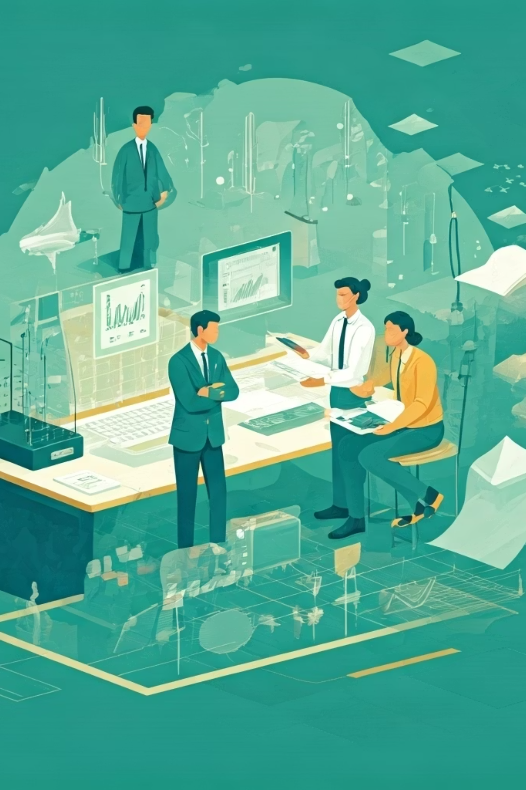
The Future of Sustainable Fishing with AI
AI-generated reports are not just data; they are powerful tools empowering data-driven decisions essential for both marine conservation and the economic growth of the fishing industry.
Collaboration between researchers, industry stakeholders, and regulators is absolutely crucial to scale this impact globally.
Together, the synergistic power of AI and sustainable fishing practices can secure the health of our oceans and ensure food security for generations to come.

